Slide 1
Otc Trading
组员： 顾一辉 茅悦田 原帅

Slide 2
通信架构
SOCKET(AIO)
MySQL
Trader Gateway
Broker Gateway
Redis
HTTP
WS
HTTP
HTTP
WS
Trader UI
Broker UI

Slide 3
Broker

Slide 4
订单处理
Order controller
Redis
Blotter controller
Waiting orders
deal
Add_DB
Add/cancel
Order book
MySQL

Slide 5
Order book
limit
stop
SELL
低
价格
limit
stop
高
BUY

Slide 6
并发控制
Case 1：deal & cancel
limit

Slide 7
并发控制
Case 2：add & cancel
limit

Slide 8
并发控制
Case 3：add & deal
limit

Slide 9
deal
价格优先，时间优先
交易的最小单元
市场深度的重叠

Slide 10
价格优先
sell
buy

Slide 11
deal业务流程
Waiting orders
redis
market
find candidate
deal
checkstop
update state
Add_DB
buy&sell depth
Order book

Slide 12
Order state
批量查询
基于 order id
Order controller
Redis

Slide 13
Finished transaction
ID generate
MySQL
Blotter controller
Add_DB
MySQL

Slide 14
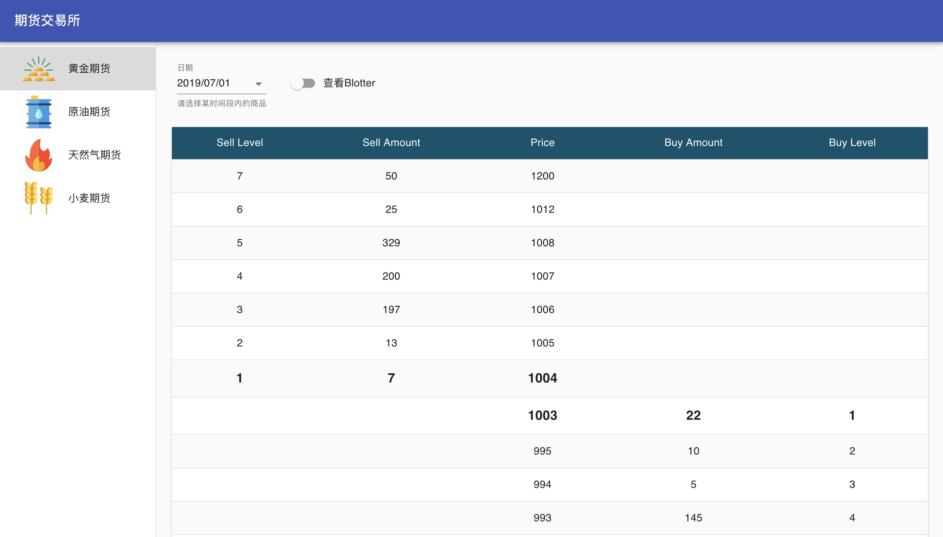
Broker gateway - Broker ui

Slide 15
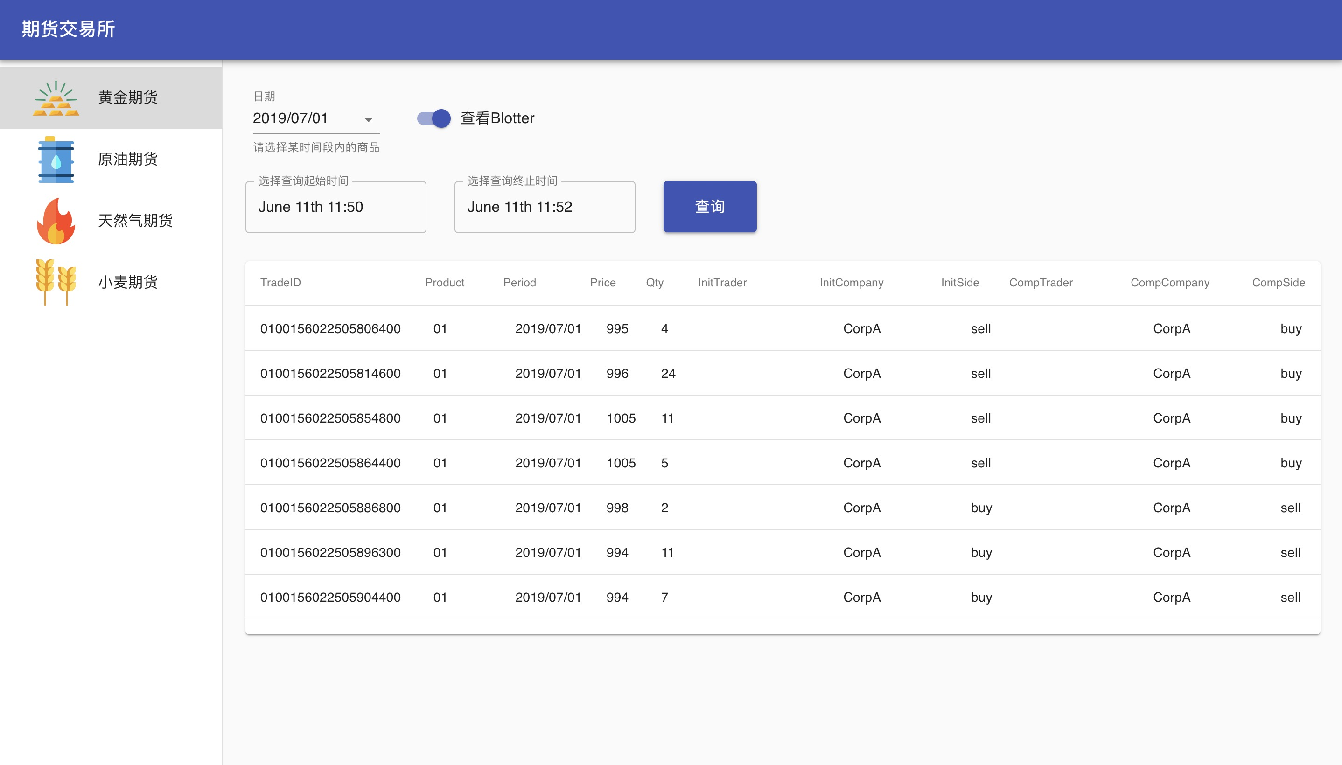
Broker gateway - Broker ui

Slide 16
Trader

Slide 17
Gateway – gateway（socket）
Connect：UUID
Subscribe
Push depth

Slide 18
Gateway – gateway（HTTP）
Rest API
Rest template配置
Send orders
query order state
query blotter

Slide 19
Gateway – gateway（HTTP）
Rest api 身份验证：uuid
请求中附上gateway socket连接时生成的uuid

Slide 20
Trader gateway 订单生成
controller
broker
Order service
Order storage
Big Order service
Big order scheduler

Slide 21
Trader gateway 订单状态、市场深度更新
broker
Gateway
Depth
Web socket
Order state service
Order storage

Slide 22
trader gateway - trader ui
UI
Session
Depth
Order state service

Slide 23
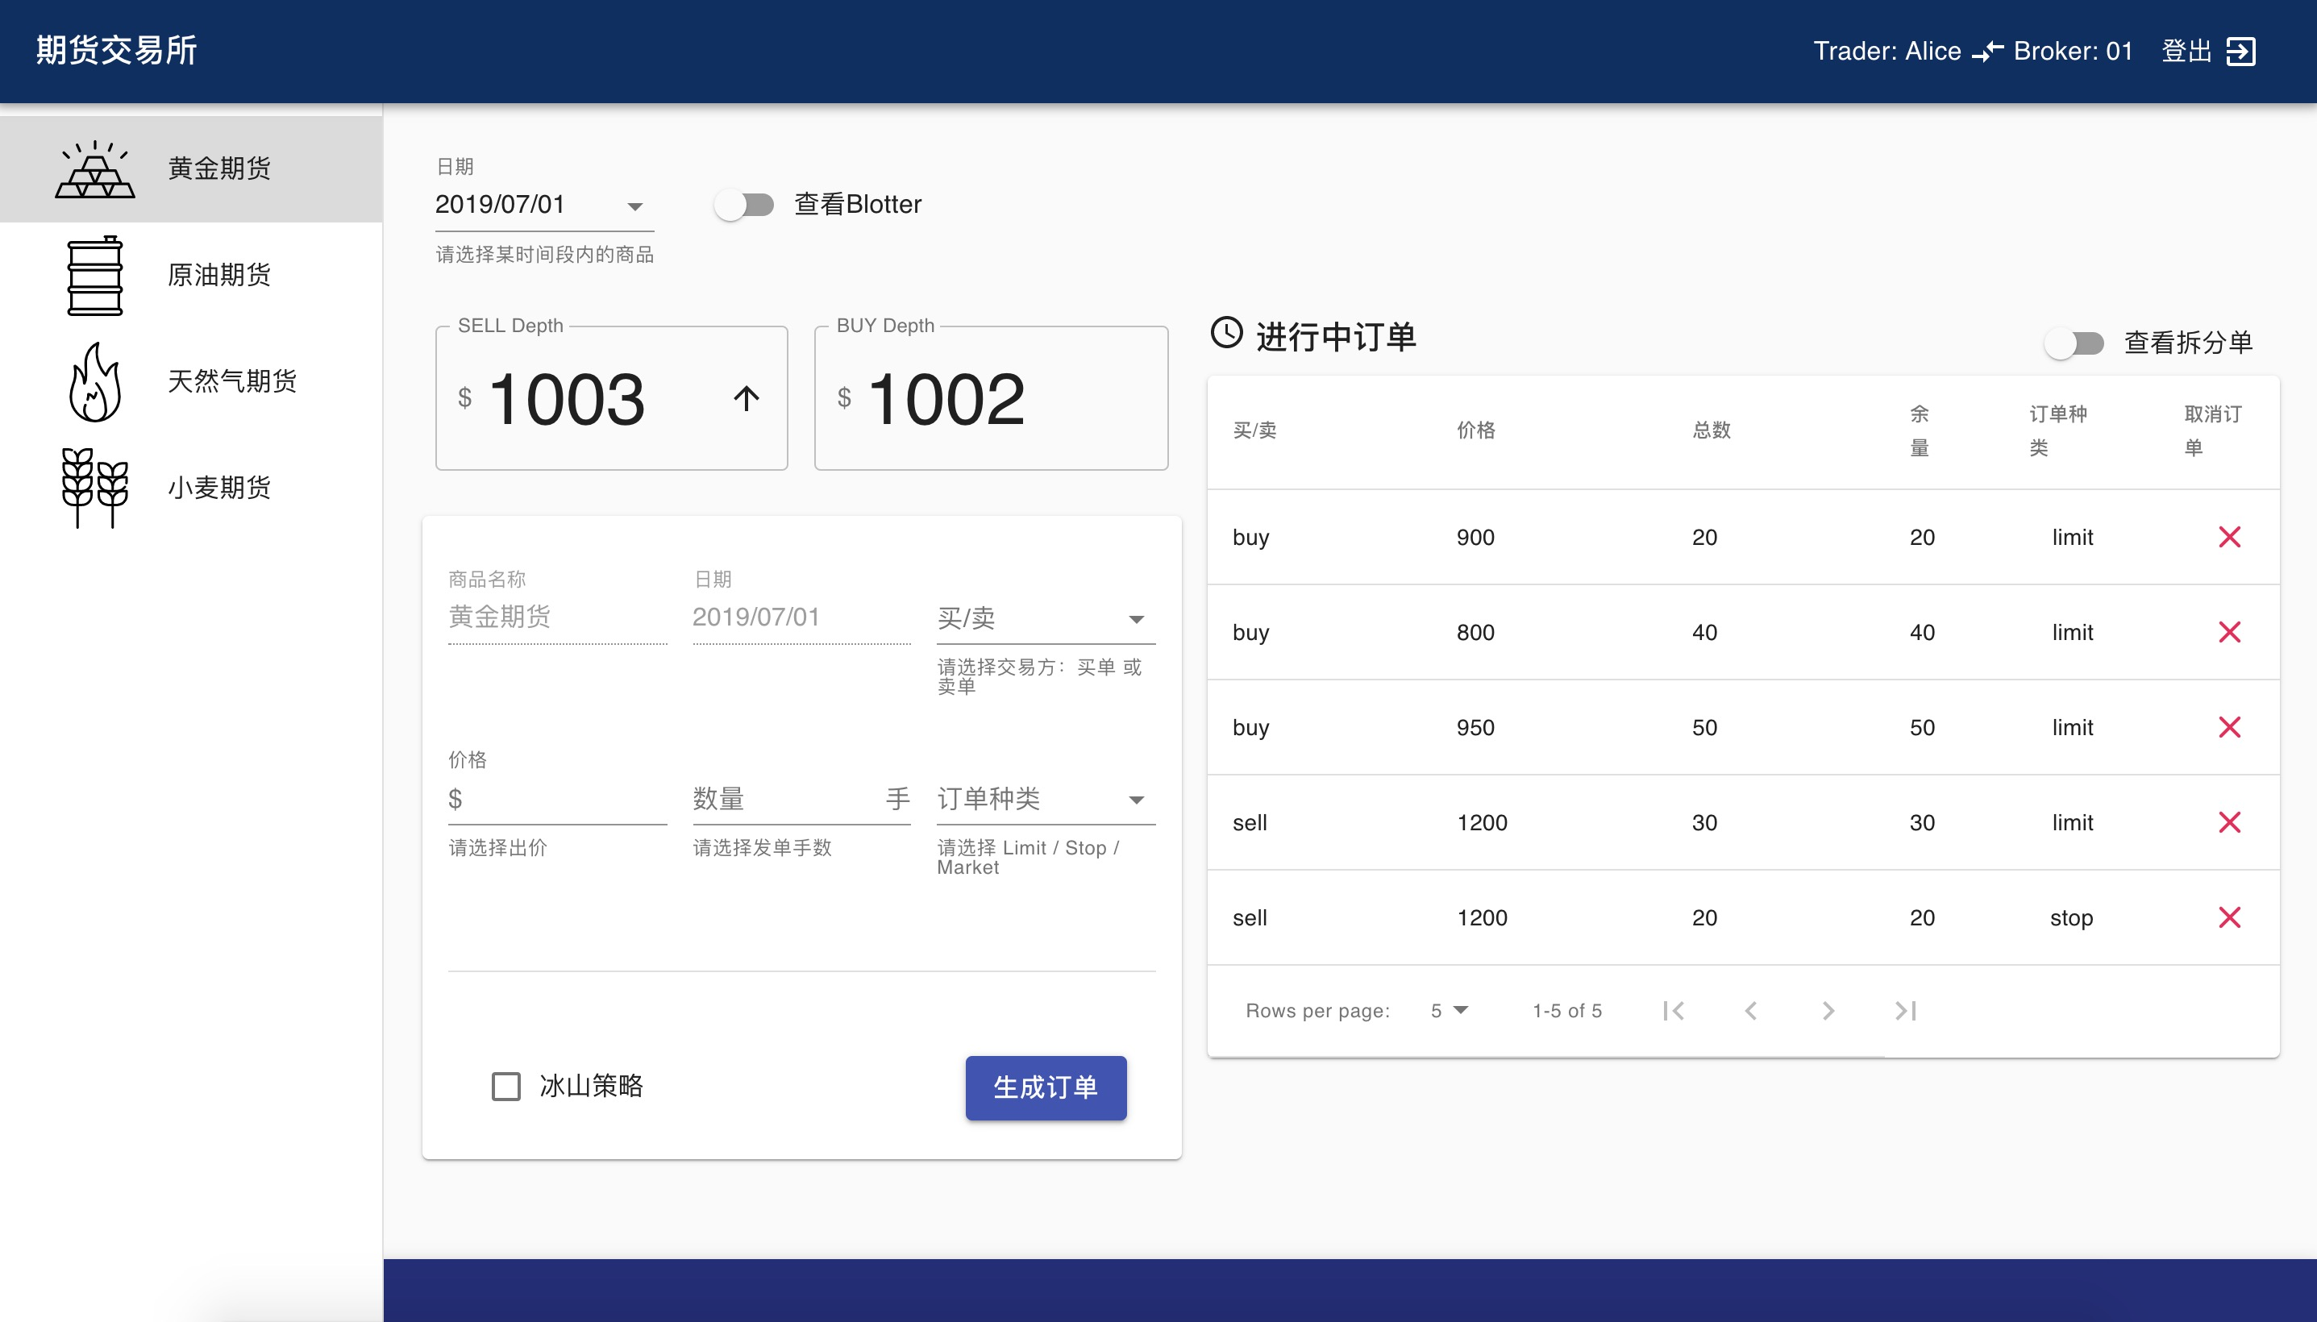
trader gateway - trader ui

Slide 24
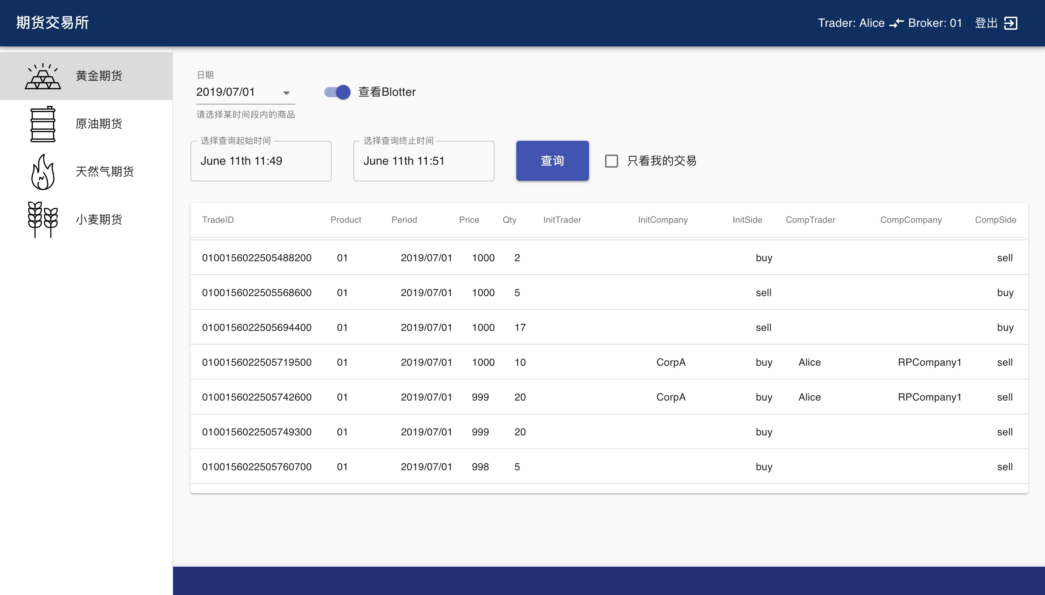
trader gateway - trader ui

Slide 25
Iceberg
TWAP
VWAP

Slide 26
Thanks!

